Slide 1
TSE6 - OpenCL
Part5
Memory optimizations

Slide 2
What’s the use of OpenCL?
OpenCL is a library that is applicable on many different architectures, ranging from normal CPU’s to GPU’s to FPGA’s
One program can run on very different architectures
OpenCL can be used as a language to design FPGA’s
See https://www.altera.com/en_US/pdfs/literature/wp/wp-01173-opencl.pdf
See also: http://amdahlsoftware.com/ten-reasons-why-we-love-opencl-and-why-you-might-too/

Slide 3
What’s the use of GPGPU?
Using OpenCL (or CUDA) for GPGPU applications has many benefits:
Accelerate image processing operations
filters, edge detection, etc
Accelerate calculations for self driving vehicles
Optimal path calculations
Predicting braking distances
Localization
Accelerate calculations for robotics
For keeping balance while walking
Controlling the motors
Feedback loop
Accelerate all kinds of other mathematical calculations
Especially those involving matrix/vector calculations
Fluid dynamics
Molecular dynamics
Weather forecasting
Create special effects in 3D rendering
By combining OpenCL with OpenGL
But also:
Less power consumption than CPU for the same calculations (https://www.youtube.com/watch?v=sDrz-w1jzEU)

Slide 4
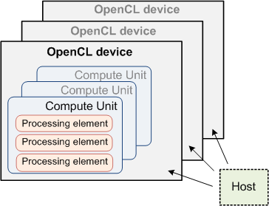
OpenCL Hardware Model
=core

Slide 5
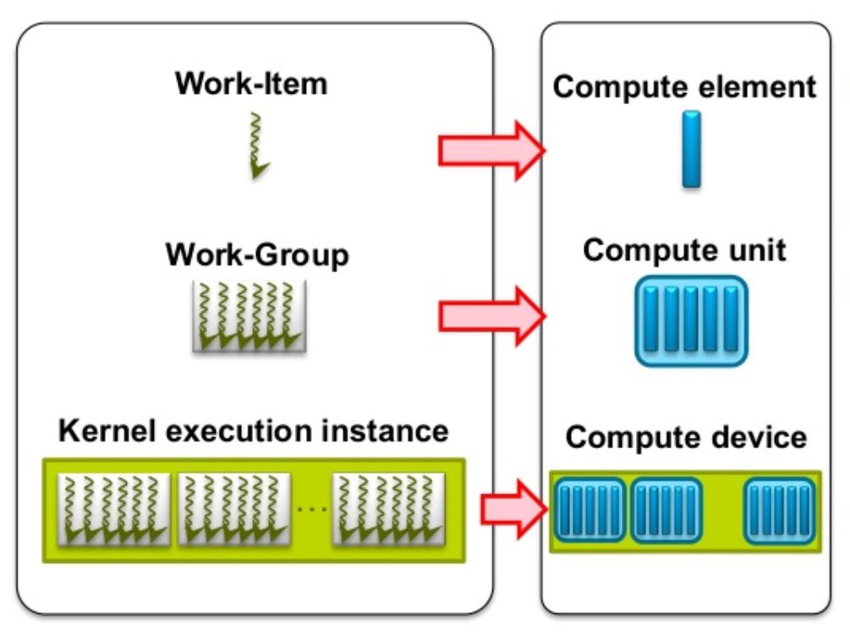
SW → HW mapping
Each Work Item (=Thread) is executed on a Processing Element (=Compute Element=core)
Several Work Items can run on one Processing Element
Each Work Group is executed on a Compute Unit
Several Work Groups can run on one Compute Unit
Kernel is running on a Compute Device

Slide 6
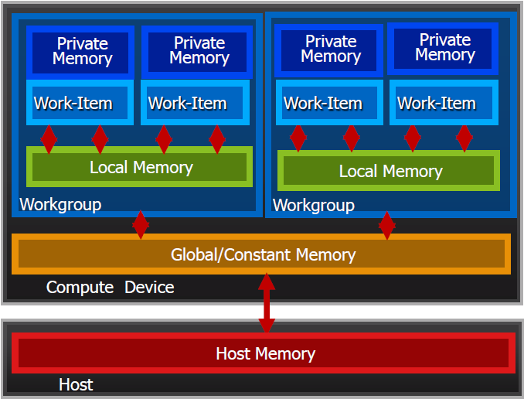
OpenCL SW Memory Model
In an OpenCL program, we can define several memory types
Private Memory
Per work-item
Local Memory
Shared within a workgroup
Global/Constant Memory
Shared between all workgroups
On the CPU
Host Memory
See also OpenCL Memory Spaces
Memory management is explicit
You must move data from host → global → local … and back

Slide 7
Memory organization in general
Memory is usually addressed on byte level
Every byte has its own address
The bytes are divided into banks
For example: memory can be divided into 4 banks, each bank 2 bytes wide:
Restriction: we can not access 2 rows of 1 bank at the same time
We can access all the green addresses simultaneously
We can not access the red addresses simultaneously
The two red rows will be accessed sequentially → takes double time!
This is a BANK CONFLICT
Bank 0 | Bank 1 | Bank 2 | Bank 3
0,1 | 2,3 | 4,5 | 6,7
8,9 | 10,11 | 12,13 | 14,15
16,17 | 18,19 | 20,21 | 22,23
… | … | … | …
Bank-row

Slide 8
General rules for optimal memory access
Accessing 1 byte from a bank-row is as fast as accessing all bytes from that row
General rule: access memory as much as possible per bank-row
Accessing bytes from different rows of the same bank takes 2 accesses
General rule: avoid accessing 2 rows of the same bank simultaneously

Slide 9
Global memory on GPU
Global GPU memory is the biggest bottleneck
Accesses to global memory take a lot of time
Typically 200 to 800 nsec per access
Compare this to the clock speed of the cores:
Suppose1GHz → 1 nsec per clock cycle
One global memory operation takes 100s of clock cycles

Slide 10
Thread switching
What happens during a global memory access?
This time is not wasted:
The threads that did the memory request are put on hold
The cores switch to another set of threads and execute these
These new threads might also have to wait for read/write
Then the cores switch to yet another set of threads
And so on…
Important fact: on a GPU, thread switching takes almost no time
A core can switch very fast from one thread to another
Important rule: keep occupancy high enough
There should always be enough threads (workgroups) allocated on a CU, so that the cores can switch to another set of threads when they have to wait for global memory access

Slide 11
Global memory organization
Global memory is often organized as 1 very wide bank
Typically 8 bytes or more, like:
In this case, for example:
bytes 16 – 23 can be read in 1 access
bytes 12 – 19 have to be read in 2 accesses
if byte 12 is being read, bytes 8-11 and 13-15 are also cached
Bank 0
0, 1, 2, 3, 4, 5, 6, 7
8, 9,10,11,12,13,14,15
16,17,18,19,20,21,22,23
24,25,26,27,28,29,30,31
…

Slide 12
Memory coalescing
To coalesce = to join together (Dutch: samenvoegen)
Threads in a work group should access global memory addresses sequentially
For example, if there are 16 threads executing the same kernel, 16 sequential positions in global memory (1 position per thread) can be accessed in the same time that it would take 1 thread to read 1 position in memory
If all memory accesses are performed this way, performance can speed up by a factor of 16 (in the memory access code)

Slide 13
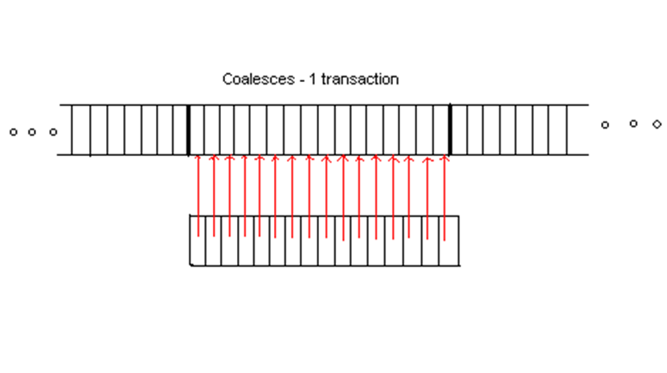
Coalesced
Optimal way to access memory
All thread accesses are sequentially, and within the same block
Everything can be read in 1 access

Slide 14
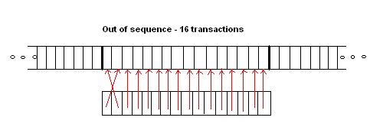
Non consecutive
Quite unpredictable
All thread accesses are within the same block, but not sequentially
Depending on the platform, this could lead to 16 accesses
Newer devices (CC1.2 and higher) handle this better (1 access)

Slide 15
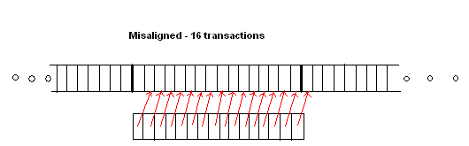
Misaligned
Not so optimal way
All thread accesses are sequential, but in consecutive blocks
Takes 2 or more accesses

Slide 16
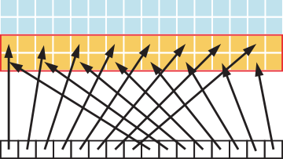
Strided access
Not so optimal
Consecutive threads skip one or more memory addresses
Multiple memory accesses are needed, depending on the stride
Stride=2

Slide 17
General guidelines
Let consecutive threads access global memory addresses consecutively
Make sure that there are ‘enough’ workgroups available per CU, so that cores can always switch to non-waiting threads

Slide 18
Local memory organization
Local memory is often organized as several narrow banks
Typically 4 bytes per bank
Assume a is an array of int’s, and we have 8 banks:
Bank 0 | Bank 1 | Bank 2 | Bank 3 | Bank 4 | Bank 5 | Bank 6 | Bank 7
a[0] | a[1] | a[2] | a[3] | a[4] | a[5] | a[6] | a[7]
a[8] | a[9] | a[10] | a[11] | a[12] | a[13] | a[14] | a[15]
… | … | … | … | … | … | … | …

Slide 19
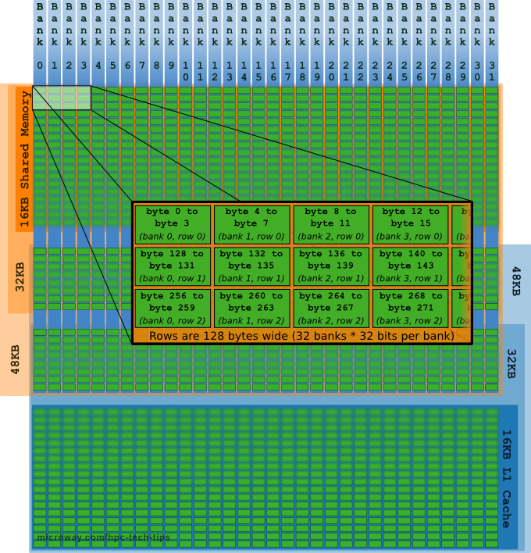
Example: Fermi local memory
Fermi has 32 banks which are 4 bytes wide
See here for more explanation

Slide 20
Reduction kernel 2 revisited
Values (Global Memory)
10 | 1 | 8 | -1 | 0 | -2 | 3 | 5 | -2 | -3 | 2 | 7 | 0 | 11 | 0 | 2
Copy from Global to Local
0
1
2
3
4
5
6
7
8
9
10
11
12
13
14
15
Values (Local Memory)
10 | 1 | 8 | -1 | 0 | -2 | 3 | 5 | -2 | -3 | 2 | 7 | 0 | 11 | 0 | 2
Step 1
Stride 1
Local IDs
Values
Local IDs
Values
Local IDs
Values
Local IDs
0
1
2
3
4
5
6
7
11 | 1 | 7 | -1 | -2 | -2 | 8 | 5 | -5 | -3 | 9 | 7 | 11 | 11 | 2 | 2
Step 2
Stride 2
0
1
2
3
18 | 1 | 7 | -1 | 6 | -2 | 8 | 5 | 4 | -3 | 9 | 7 | 13 | 11 | 2 | 2
Step 3
Stride 4
0
1
24 | 1 | 7 | -1 | 6 | -2 | 8 | 5 | 17 | -3 | 9 | 7 | 13 | 11 | 2 | 2
Step 4
Stride 8
0
41 | 1 | 7 | -1 | 6 | -2 | 8 | 5 | 17 | -3 | 9 | 7 | 13 | 11 | 2 | 2
Copy result back to Global
0
41

Slide 21
Example of memory bank conflict
In reduction kernel, version 2 (week 2), 8 threads active in step 1
Suppose again we have 8 banks, each 1 int (4 bytes) wide:
Thread 0 accesses first a[0] and then a[1], and thread 4 accesses first a[8] and then a[9], → bank conflict
Similar for all the other threads
Similar in all other steps
Bank 0 | Bank 1 | Bank 2 | Bank 3 | Bank 4 | Bank 5 | Bank 6 | Bank 7
a[0] | a[1] | a[2] | a[3] | a[4] | a[5] | a[6] | a[7]
a[8] | a[9] | a[10] | a[11] | a[12] | a[13] | a[14] | a[15]
… | … | … | … | … | … | … | …

Slide 22
How to avoid memory bank conflicts
What goes wrong exactly in the previous kernel?
Threads perform the addition with the following statement:
sdata[index] += sdata[index+s]; where index = 2*s*tid:
This statement is executed as follows:
Read sdata[index] from memory
Read sdata[index+s] from memory
Add the 2 values in the core
Write the result to sdata[index]
Note: the cores execute the above 4 steps in lock-step: all do the same at the same time with different values for index
In all the steps 1), 2) and 4) memory bank conflicts occur
It would be better if, in step 1), 2) and 4), subsequent cores access subsequent memory locations

Slide 23
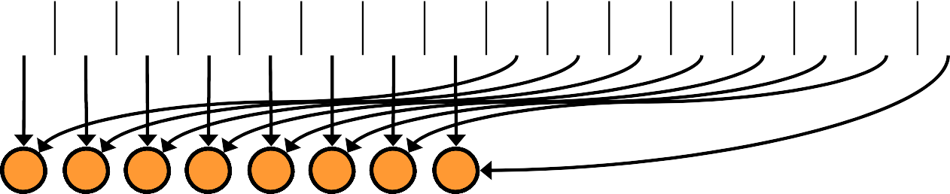
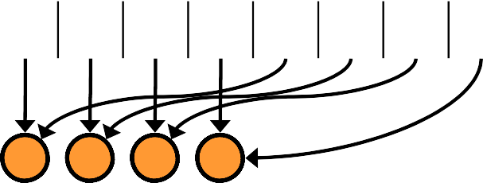
Reduction kernel 4: sequential access
Values (Global Memory)
10 | 1 | 8 | -1 | 0 | -2 | 3 | 5 | -2 | -3 | 2 | 7 | 0 | 11 | 0 | 2
Copy from Global to Local
0
1
2
3
4
5
6
7
8
9
10
11
12
13
14
15
Values (Local Memory)
10 1 8 -1 0 -2 3 5 -2 -3 2 7 0 11 0 2
Step 1
Stride 1
Local IDs
Values
Local IDs
Values
Local IDs
Values
Local IDs
0
1 2 3 4 5 6 7
8 | -2 | 10 | 6 | 0 | 9 | 3 | 7 | -2 | -3 | 2 | 7 | 0 | 11 | 0 | 2
Step 2
Stride 2
0
1 2 3
8 | 7 | 13 | 13 | 0 | 9 | 3 | 7 | -2 | -3 | 2 | 7 | 0 | 11 | 0 | 2
Step 3
Stride 4
0
1
21 | 20 | 13 | 13 | 0 | 9 | 3 | 7 | -2 | -3 | 2 | 7 | 0 | 11 | 0 | 2
Step 4
Stride 8
0
41 | 20 | 13 | 13 | 0 | 9 | 3 | 7 | -2 | -3 | 2 | 7 | 0 | 11 | 0 | 2
Copy result back to Global
0
41

Slide 24
Useful links
A similar discussion about optimization, but applied to dot-product: http://www.cmsoft.com.br/opencl-tutorial/optimization-strategies/
A short article about memory coalescing: http://www.azavea.com/blogs/labs/2010/07/gpu-memory-bandwidth/
About dynamical Local Memory allocation: http://www.openclblog.com/2014/10/allocating-local-memory.html

